Slide 1
Linear Time Invariant (LTI) system lecture 7

Slide 2
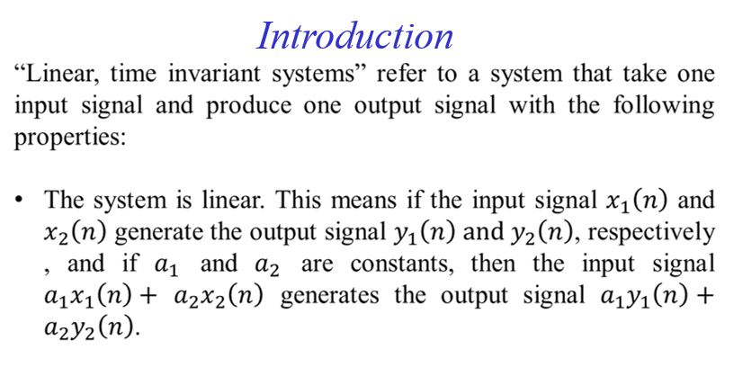
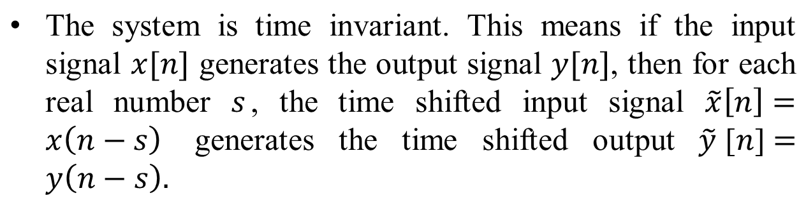

Slide 3
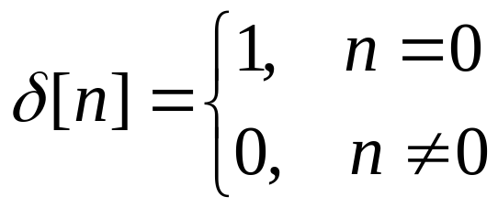
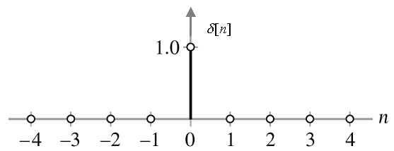
Introduction
The first important fact concerning the behavior of discrete–time LTI systems is that the response of the system to any input is completely determined by its response to one special input, the unit impulse at time 0. This special input is Unit Impulse Function or Dirac delta function.
The discrete time version of the unit impulse is defined by,

Slide 4
Unit Impulse Function or Dirac delta function
The discrete time version of the unit impulse is defined by,
When the impulse signal is applied to a linear system, then the response of the system is called the impulse response. We can use it to describe an LTI system and predict its output for any input.

Slide 5
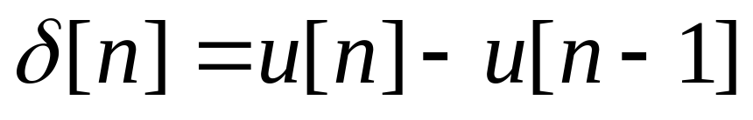
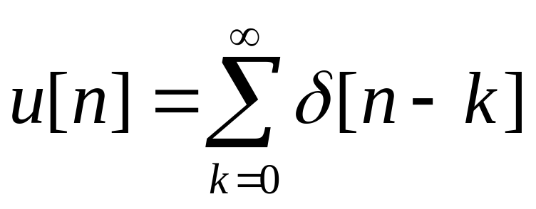
Unit Impulse Function
There is a close relationship between the discrete-time unit impulse and unit step. In particular, the discrete time unit impulse is the first difference of the discrete-time step;
Conversely discrete time unit step can be written in terms of discrete time unit impulse as

Slide 6
Unit Impulse Function
Show that (Graphically),
Show that (Graphically),

Slide 7
Unit Impulse Function
The unit impulse sequence can be used to sample the value of a signal at n=0. Since δ[n] is nonzero (and equal to 1) only for n=0, it follows that
x[n] δ[n] = x[0] δ[n]

Slide 8
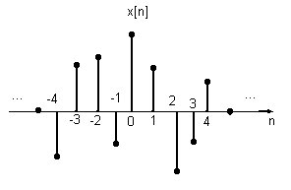
The representation of Discrete-Time Signals in Terms of impulses
The Key idea in visualizing how the discrete-time unit impulse can be used to construct any discrete-time signal is to think of a discrete-time signal as a consequence of individual impulses. Consider the signal x[n] shown below;

Slide 9
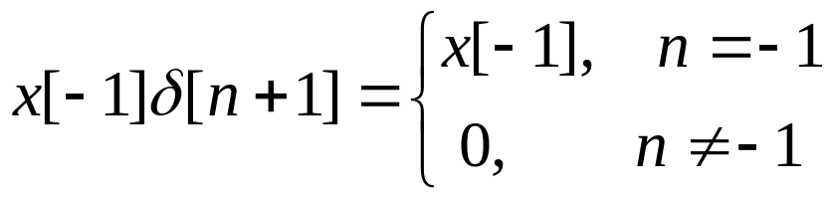
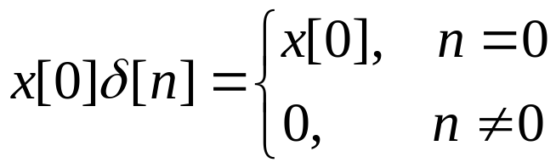
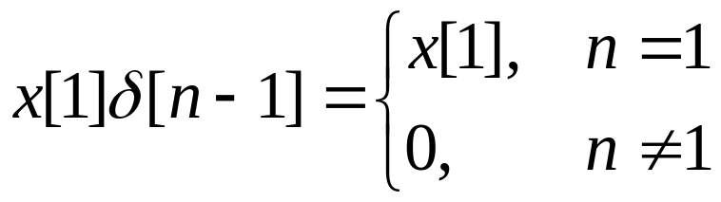
Cont.
It can be represented as the summation of five time-shifted, scaled unit impulse sequences, where scaling on each impulse equals the value of x[n] at the particular instant the unit sample occurs.
For example,

Slide 10
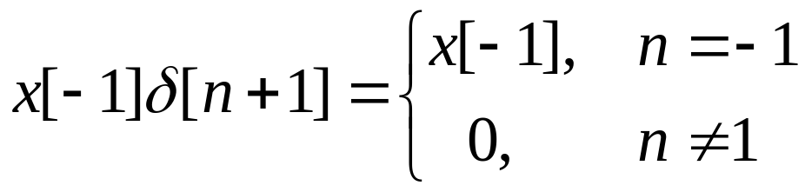
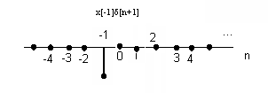
Cont.

Slide 11
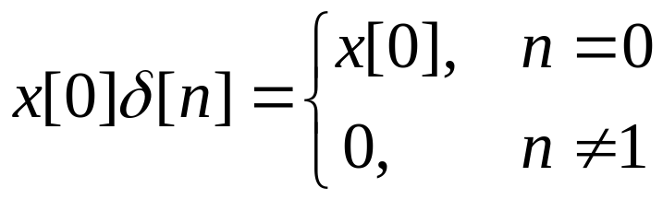
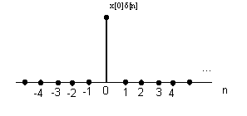
Cont.

Slide 12

Cont.

Slide 13
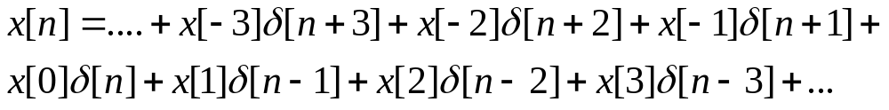
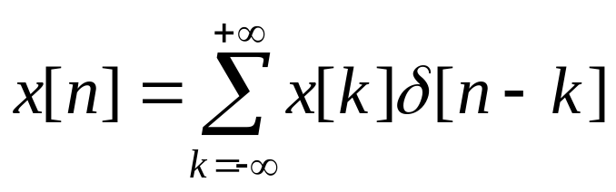
Cont.
In similar way by including additional shifted, scaled impulses, we can write,
Writing this summation in more compact form, we have,
This corresponds to the representation of an arbitrary sequence as a linear combination of shifted unit impulses δ[n-k], where the weights in this linear combination are x[k].

Slide 14
Time domain representation of Linear Time-Invariant System
Characterizing an LTI system in terms of its Impulse Response
The impulse response completely characterize the behavior of any LTI system. This is the basic property of all LTI systems.

Slide 15
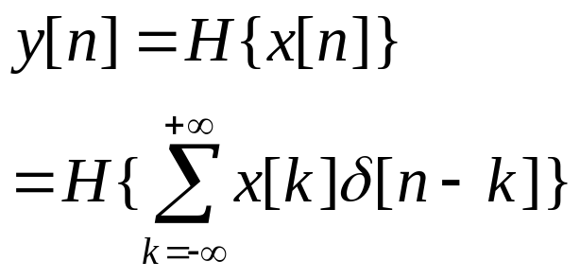
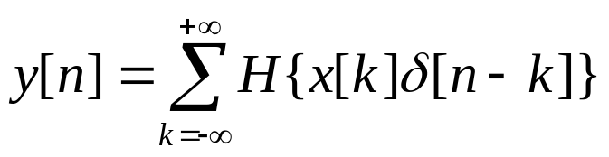
Characterizing an LTI system in terms of its Impulse response
We know that,
Let the operator H denote the system to which the input x[n] is applied. Then we have,
Now we use the linearity property to interchange the system operator H with the summation and obtained

Slide 16
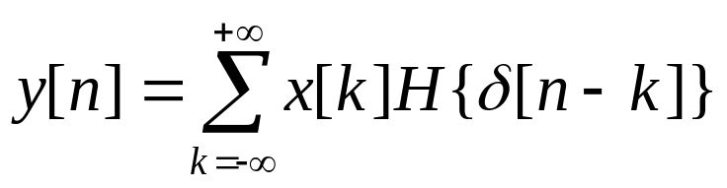
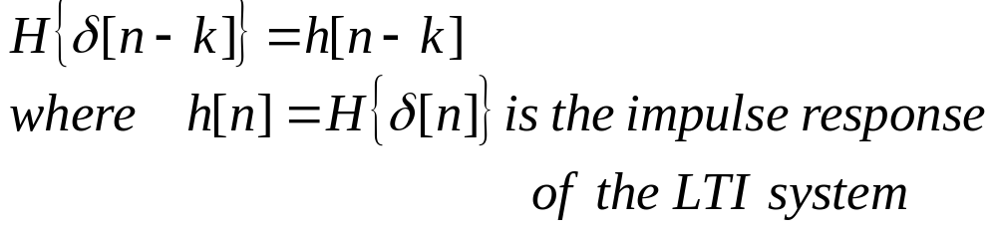
Characterizing an LTI system in terms of its Impulse response
Since n is the time index, the quantity x[k] is a constant with respect to the system operator. Using linearity again, we interchange H with x[k] to obtain
This equation indicates that the system output is a weighted sum of the response of the system to time-shifted pulses. Again assume that the system is time-invariant. This relationship implies that

Slide 17
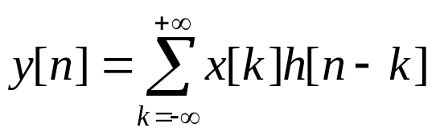
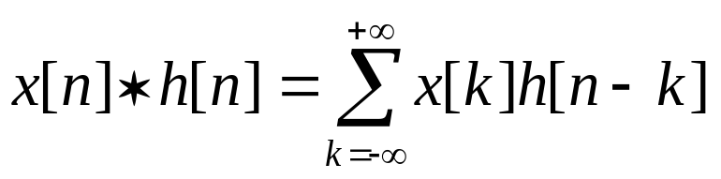

Characterizing an LTI system in terms of its Impulse response
Hence the equation
becomes
Thus, the output of an LTI system is given by a weighted sum of a time-shifted impulse response. The sum shown in the equation above is termed as convolution sum and is denoted by the symbol *. That is,

Slide 18
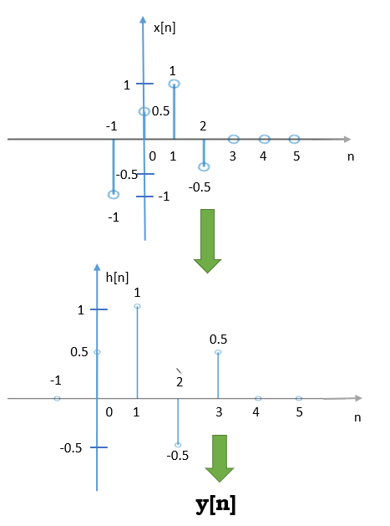
Characterizing an LTI system in terms of its Impulse response
Problem
The input x[n] of a LTI system:
The impulse response of the system:
Find out y[n].

Slide 19
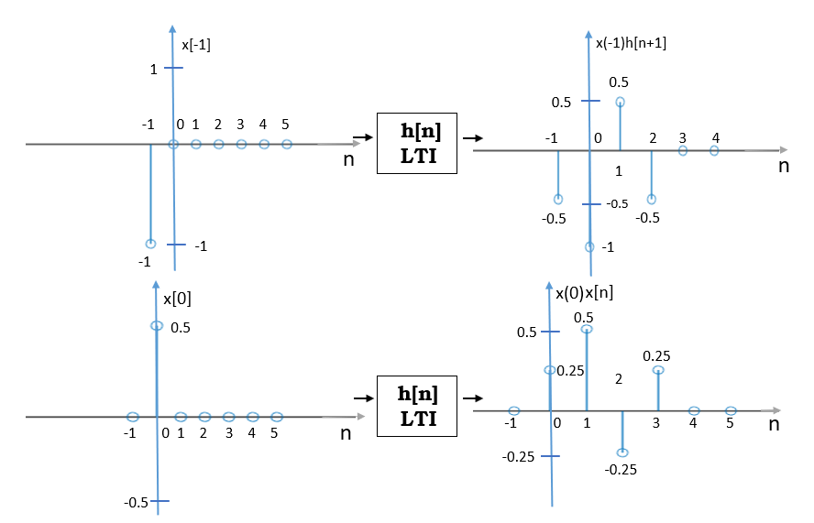
Characterizing an LTI system in terms of its Impulse response
Solution

Slide 20
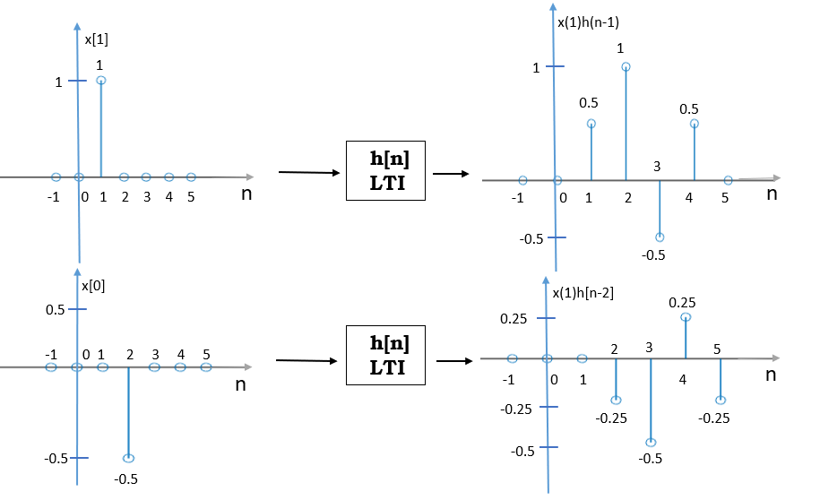
Characterizing an LTI system in terms of its Impulse response
Solution

Slide 21
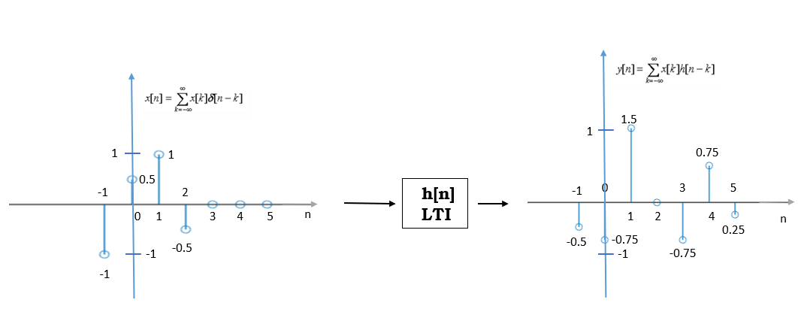
Characterizing an LTI system in terms of its Impulse response
Solution

Slide 22
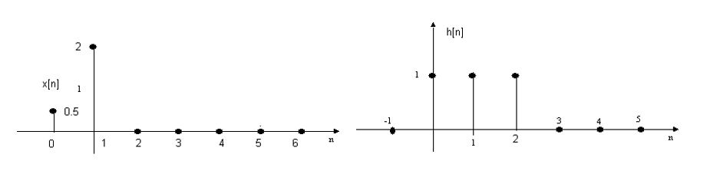
Characterizing an LTI system in terms of its Impulse response
Problem

Slide 23
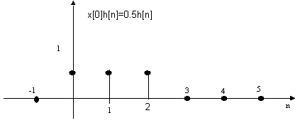
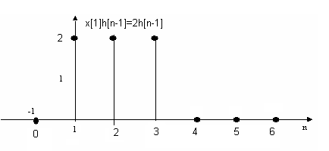
Characterizing an LTI system in terms of its Impulse response
Solution
y[n]=??

Slide 24
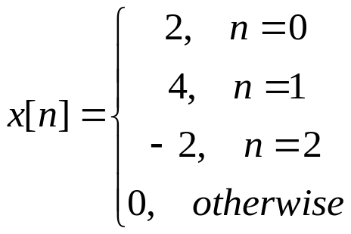
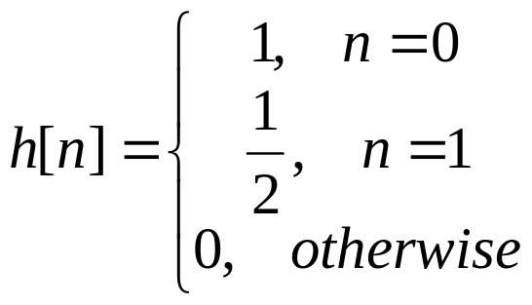
Characterizing an LTI system in terms of its Impulse response
Problem
Determine the output of the LTI system in response to the input
The impulse response of the system is,

Slide 25
Convolution Sum Evaluation Procedure
Determining y[n]:
Find the output corresponding to each time-shifted impulse and then summed each weighted, time-shifted impulse response.
This approach is effective when the input is of brief duration so that only a small number of time-shifted impulse responses need to be summed.
When the input is of long duration, the procedure can be cumbersome.

Slide 26
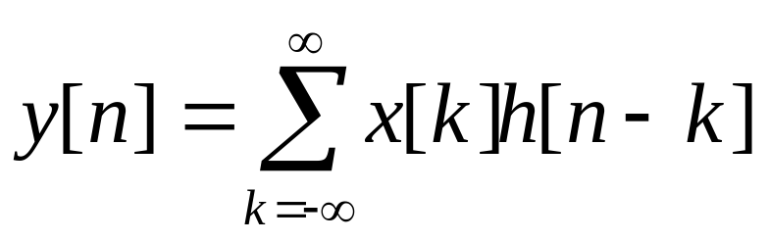
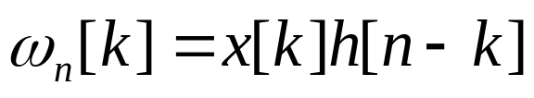
Convolution Sum Evaluation Procedure
Determining y[n]:
The convolution sum is expressed as
Let,
In this definition k is the independent variable and n is treated as a constant. Now, h[n-k]=h[-(k-n)] is a reflection and time shifted version of h[k].

Slide 27
Convolution Sum Evaluation Procedure
Determining y[n]:
Hence, if n is negative, then h[n-k] is obtained by time shifting h[-k] to the left while if n is positive, we time shift h[-k] to the right.

Slide 28
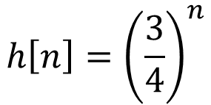
Convolution Sum Evaluation Procedure
Problem:
Consider a system with impulse response
u[n]
Determine the output of the system at time n=-5, n=5, and n=10 when the input is x[n]=u[n].

Slide 29
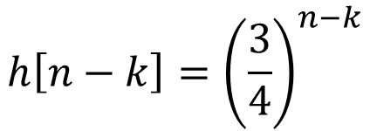


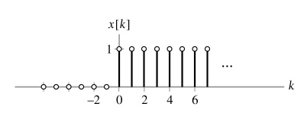
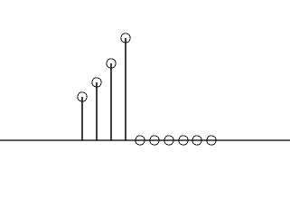
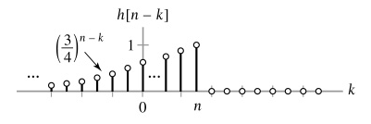
Convolution Sum Evaluation Procedure
Solution:
….
-3 -2 -1 0 1 2 3 4 5 6 k

Slide 30
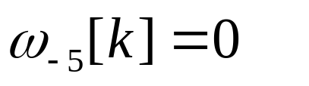

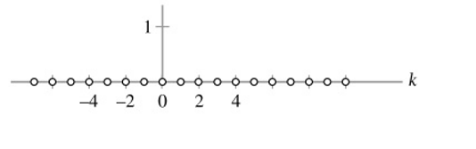
Convolution Sum Evaluation Procedure
Solution:
For n=-5 we have,
Then y[-n]=0 for n=-5.

Slide 31
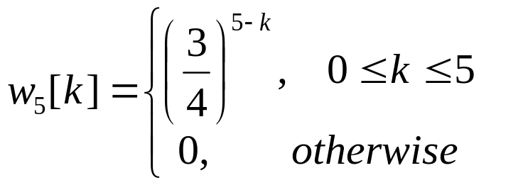
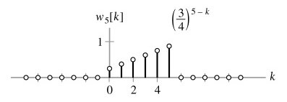
Convolution Sum Evaluation Procedure
Solution:
For n=5 we have,

Slide 32
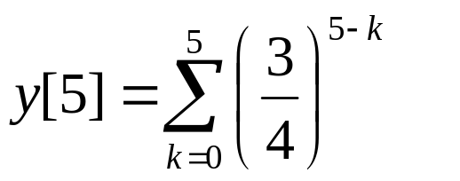
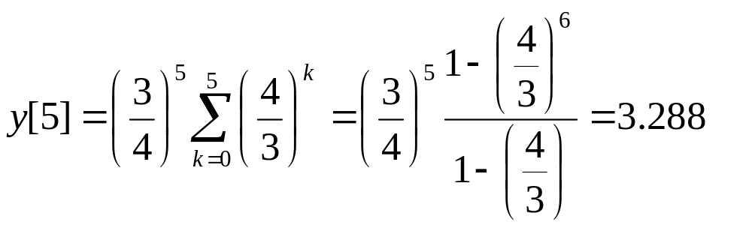
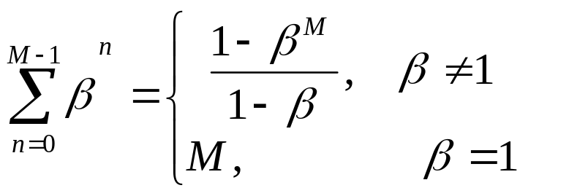
Convolution Sum Evaluation Procedure
Solution:
For n=5 we have,
Given

Slide 33
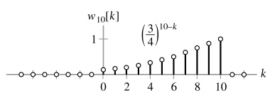
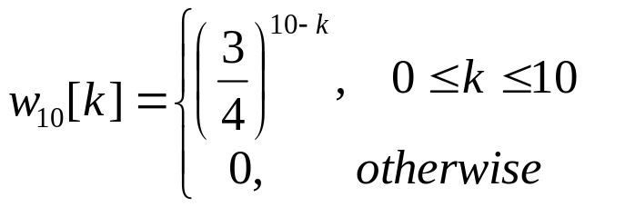
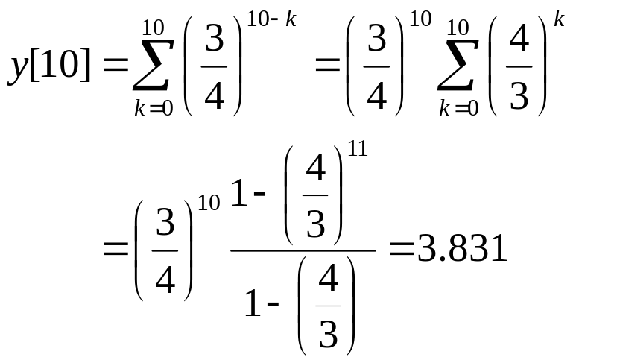
Convolution Sum Evaluation Procedure
Solution:
For n=10 we have,

Slide 34
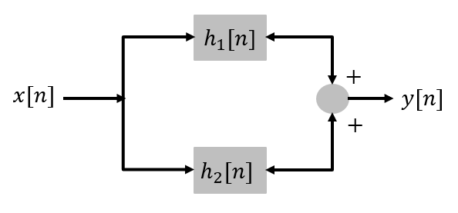
Parallel Connection of LTI System
Distributive Property:
Consider an input x[n] in fed through two LTI systems with impulse responses h₁[n] and h₂[n] connected in parallel, as illustrated in figure below:
The output of this connection of systems, y(t), is the sum of the outputs of the systems.

Slide 35
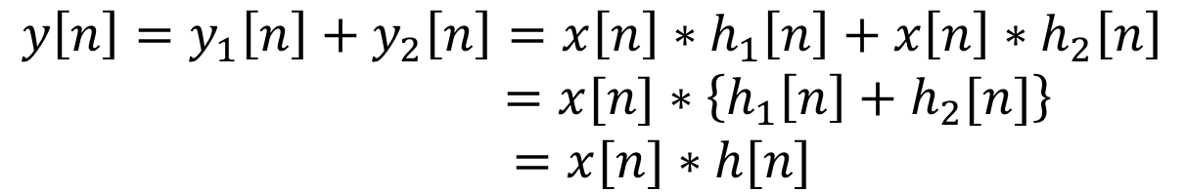

Parallel Connection of LTI System
Distributive Property:
Hence impulse response of the overall system represented by the two LTI systems connected in parallel is the sum of their individual impulse responses.

Slide 36
Parallel Connection of LTI System
Distributive Property:
Mathematically, this result implies that convolution possesses the distributive property:

Slide 37





Cascade Connection of systems
Associative property
Consider two LTI systems with impulse responses h₁[n] and h₂[n] connected in series, as illustrated in figure below:
Hence,

Slide 38

Cascade Connection of systems
Associative property
Hence the impulse response of an equivalent system representing two LTI systems connected in cascade is the convolution of their individual impulse responses.

Slide 39

Cascade Connection of systems
Associative property
Mathematically, this result implies that convolution possesses the associative property:

Slide 40
Cascade Connection of systems
Communicative property
A third property for the cascade connection of LTI systems concerns the ordering of the systems.
Consider two LTI systems with impulse responses h₁[n] and h₂[n] connected in series, as illustrated in figure below:

Slide 41


Cascade Connection of systems
Communicative property

Slide 42


Cascade Connections of systems
Communicative property

Slide 43

Some important convolution

Slide 44


Example
Consider the interconnections of four LTI systems. As depicted in figure below. The impulse responses of the systems are
Find the impulse response h[n] of the overall system.

Slide 45

Solution
We first derive an expressions for the overall impulse response in terms of the impulse response of each system.
Distributive Property
Associative Property
Distributive Property

Slide 46

Solution

Slide 47



Problem
Find the expression for the impulse response relating the input x[n] to the output y[n] for the system depicted in figure below.

Slide 48

Problem
Find the expression for the impulse response relating the input x[n] to the output y[n] for the system depicted in figure below.

Slide 49
Problem
Find the expression for the impulse response relating the input x[n] to the output y[n] for the system depicted in figure below.

Slide 50
Memoryless LTI System
The impulse response completely characterizes the input-output behavior of an LTI system. Therefore the properties of the system, such as the memory, the causality, and the invertibility, are related to the system’s impulse response. The convolution sum is expressed as,

Slide 51

Memoryless LTI System-Cont.
The output of a memoryless LTI system depends only on the current input. Exploiting the communicative property of convolution, we may express the output of a discrete-time LTI system as
It is instructive to expand the sum term by term:
For this system to be memoryless, y[n] must depend only on x[n] and therefore cannot depend on x[n-k] for k≠0. Hence every term in the above equation must be 0, except h[0]x[n].

Slide 52


Memoryless LTI System-Cont.
The memoryless condition places severe restrictions on the form of the impulse response: all the memoryless LTI systems simply perform scalar multiplication on the input.
If a discrete-time system has an impulse response h[n] that is not identically 0 for n ≠0, then the system has memory.

Slide 53
Memoryless LTI System-Cont.
The memoryless condition places severe restrictions on the form of the impulse response: all the memoryless LTI systems simply perform scalar multiplication on the input.
If a discrete-time system has an impulse response h[n] that is not identically 0 for n ≠0, then the system has memory.

Slide 54
Causal LTI systems
The output of a causal LTI system depends only on past or present values of the input.
We write the convolution sum as:

Slide 55
Invertible Systems and Deconvolution
of LTI systems
A system is known as invertible only if an inverse system exists which, when cascade with the original system, produces the input of the original system. If an LTI system is invertible then it will have a LTI inverse system.
The process of recovering x(t) from h(t)*x(t) is termed deconvolution, since it corresponds to reversing or undoing the convolution process. An inverse system performs deconvolution.

Slide 56






Invertible Systems and Deconvolution
of LTI systems
h[n])

Slide 57





Invertible Systems and Deconvolution
of LTI systems
So the obvious condition is
Output of the first system
Output of the second system

Slide 58
Invertible Systems and Deconvolution
of LTI systems
The common application of such a system is in communications technology and storage retrieval. For example you want to receive what you sent and in storage retrieval you basically want to retrieve right information.

Slide 59
Invertible Systems and Deconvolution
of LTI systems
The process of recovering x(t) from h(t)*x(t) is termed deconvolution, since it corresponds to reversing or undoing the convolution process. An inverse system performs deconvolution.

Slide 60
Invertible Systems and Deconvolution
of LTI systems
Notes: The impulse response is often written using the letter h, as h[n]. For example, the identity system has h[n]=δ[n].

Slide 61
End

